Slide 1
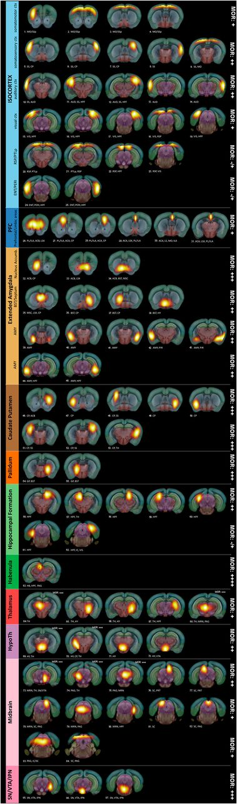
Open-ended high-dimensional spatial ICA reveals anatomically well-defined brain components or nodes.
Anna E. Mechling et al. PNAS 2016;113:11603-11608
©2016 by National Academy of Sciences
Notes:
Open-ended high-dimensional spatial ICA reveals anatomically well-defined brain components or nodes. Spatial ICA using ICASSO (Gift-Group ICA of fMRI Toolbox v.1.3i, www.nitrc.org/projects/gift/) was performed on 28 combined control and Oprm1^{−/−} datasets. From the 100-ICASSO results, 13 artifactual components related to CSF; vascular- or movement-related pseudoactivations were excluded from analysis. The analysis revealed 87 meaningful components or nodes, displayed as spatial color-coded z-maps (threshold 3.0) onto the AMBA, and arranged according to their affiliation to broader brain areas: Isocortex (MO, SS, AUD, VIS, RSP and PTLp areas, ENT and PIR), PFC (prefrontal and limbic areas), extended amygdala (ACB, BST, AMY), caudate putamen, pallidum, HPF, HB, TH, HY, MB, and VTA/IPN. MOR expression levels were estimated for each broad brain area, according to Erbs et al. (10), and marked on the right side of each image row.

